Slide 1
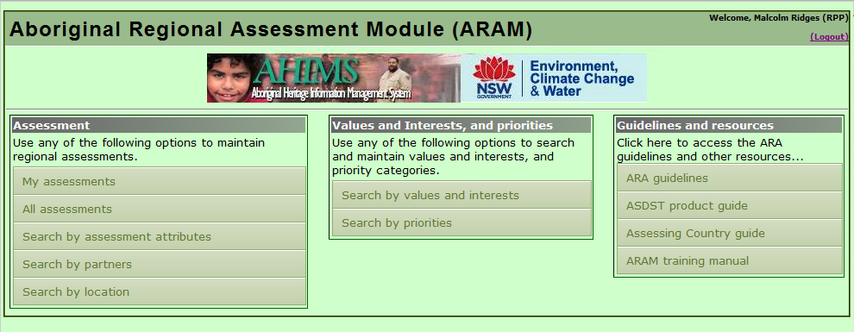


Managing sensitive data
The ARAM system
Mal Ridges

Slide 2
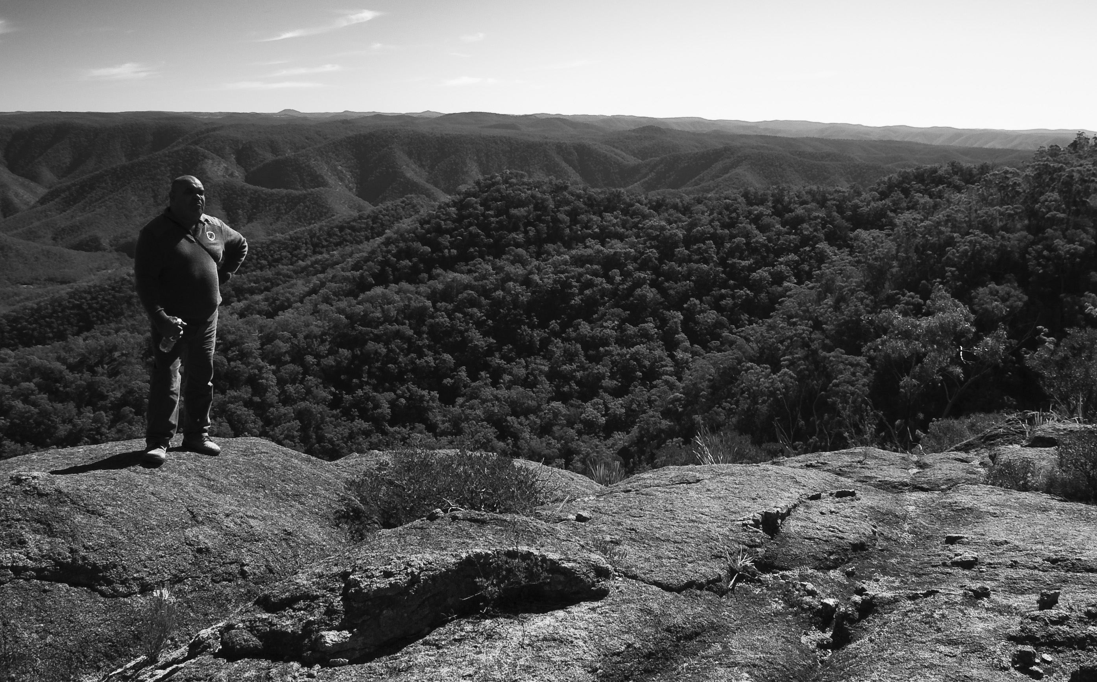
What is ‘sensitive’ data?
ALL data is sensitive
Doesn’t matter if its data of TOs; IP from Uni research; or proponents paying for archaeological investigation
Why?
Because analysis of data always has the potential to impact PEOPLE
We must RESPECT this fact

Slide 3
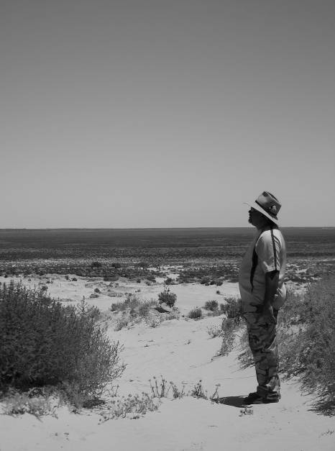
How do we deal with this?
In ARAM we took the approach that ALL underlying ‘hairy’ data remains in the control of its custodian
BUT…there is a difference between ‘data’ (hairy) and ‘information’ (smooth)
Uncontrolled analysis of data can harm, but application of information can do good
Data = core facts (ie where sites are, what they contain, traditional knowledge about them)
Information = what is derived from that data for a particular purpose (ie to drive outcomes in a regional assessment)
Data is relatively static, information is derived fit for purpose

Slide 4
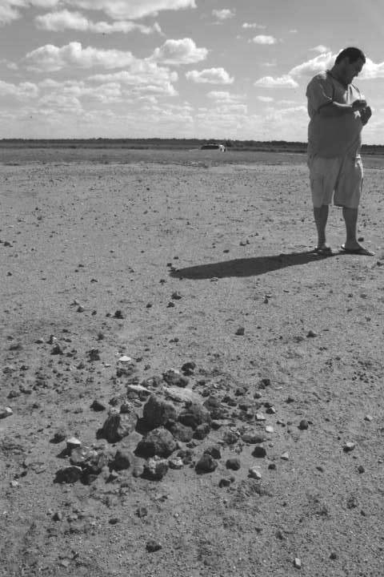
A database for information
The purpose of ARAM was to store INFORMATION (with or without data)
Reason: because information is what drives outcomes
ARAM deal with this at three levels:
1) Generic information about the project (ie metadata)
2) the underlying data: access restrictions and VIP method

Slide 5
ARAM
Corporate
GIS
Aboriginal Regional Assessment Module
Satellite imagery
Contextual data
User rights
AHIMS
Aboriginal heritage
information management
system
ARAM
Web interface +
online mapping
Data server
VIP data
Statutory database
VIP mapping
methodology

Slide 6
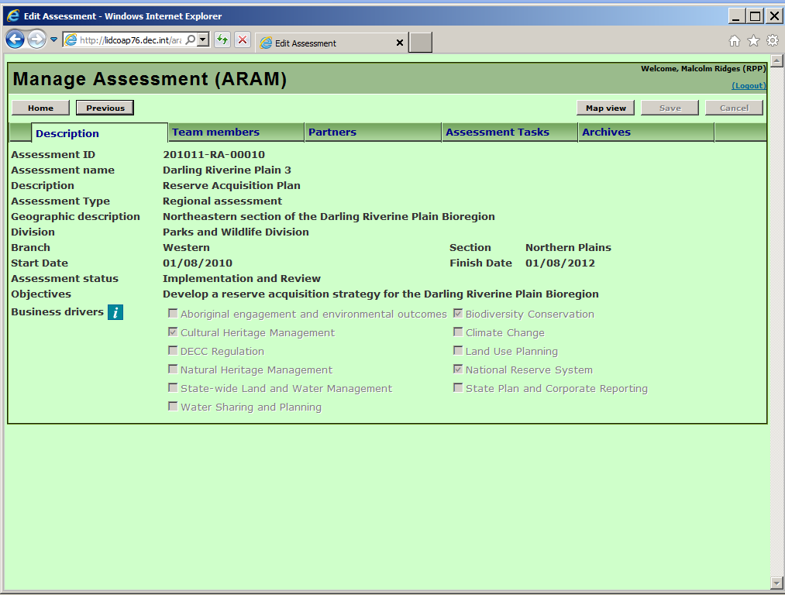
Top level information: generic information (metadata)

Slide 7
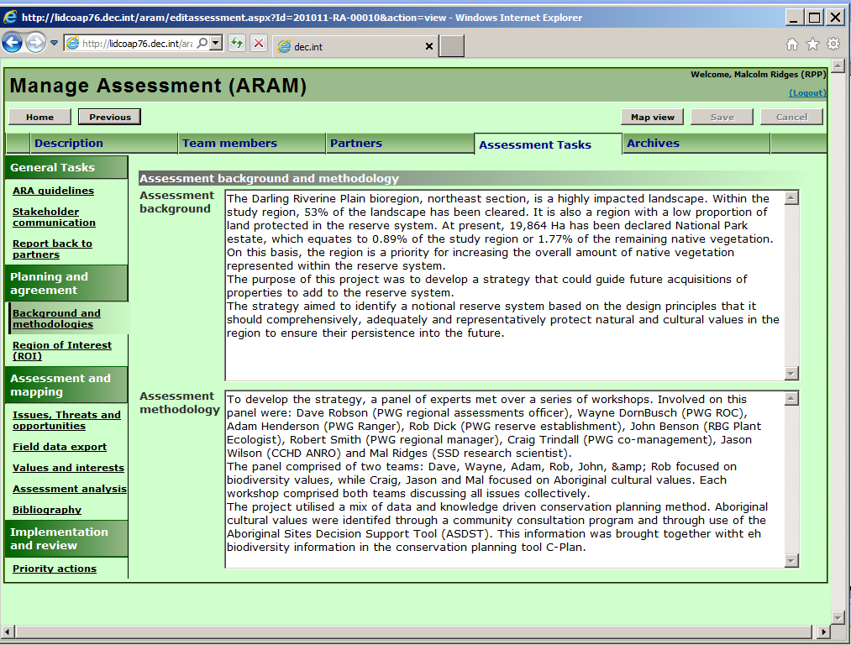
Top level information: generic information (metadata)

Slide 8
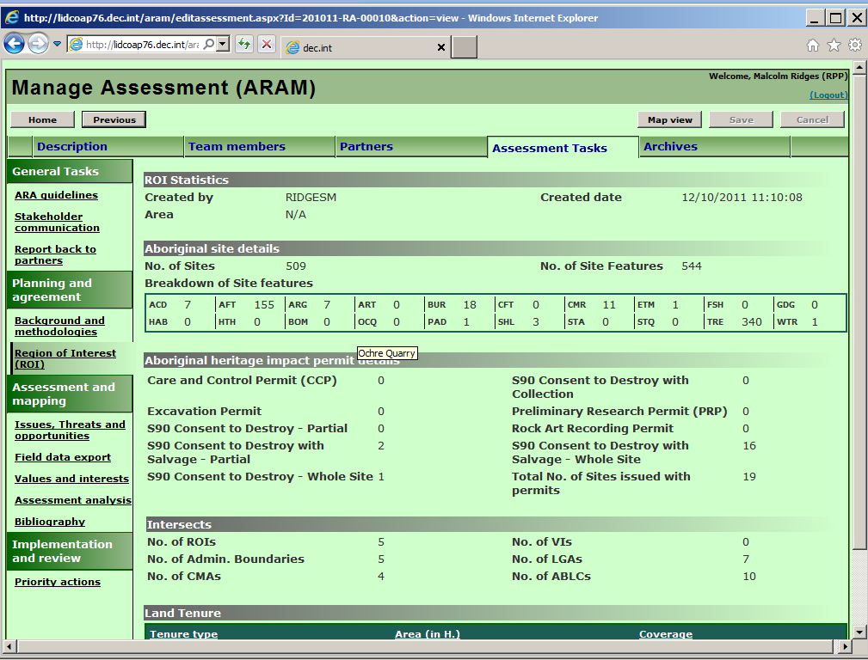
Top level information: generic information (metadata)

Slide 9
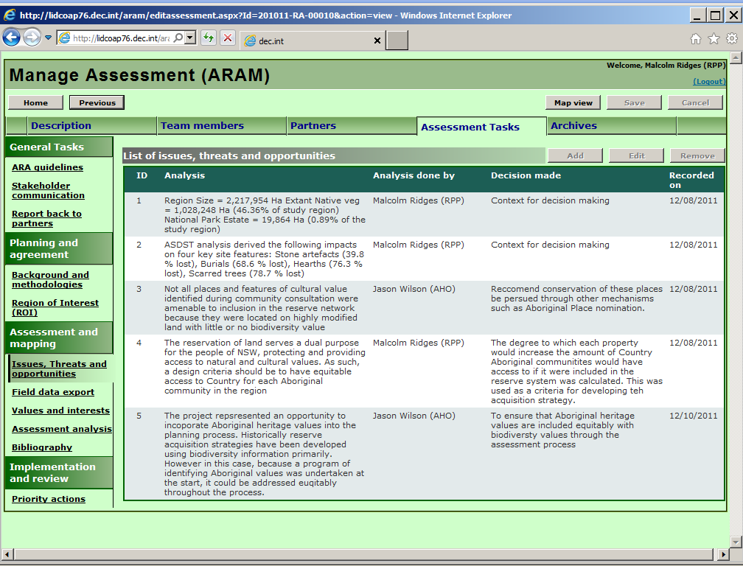
Top level information: generic information (metadata)

Slide 10
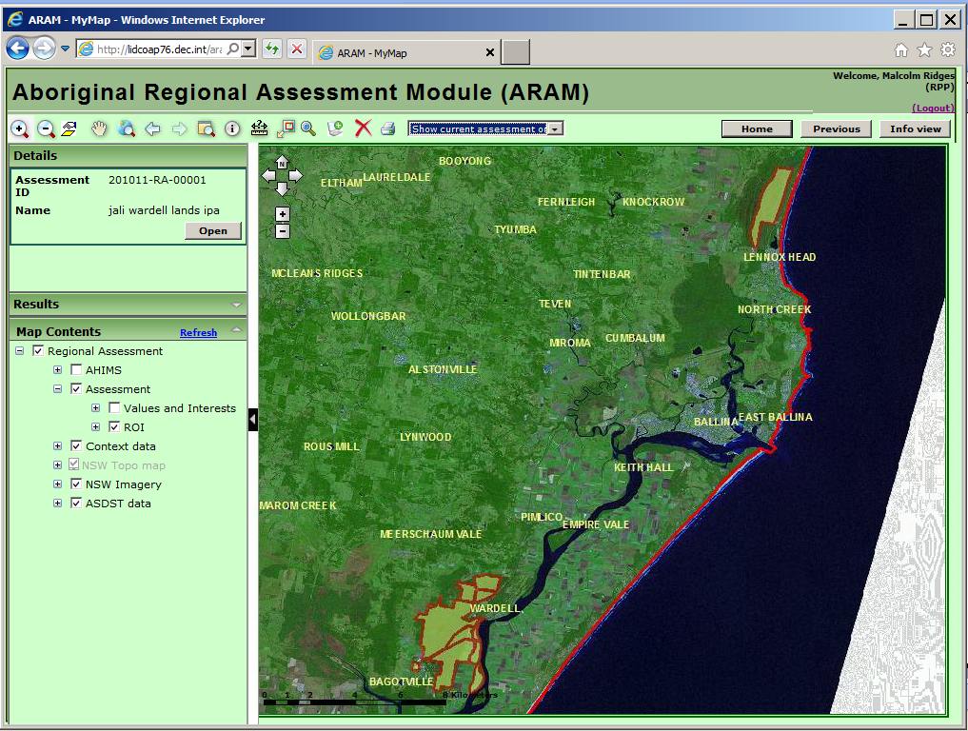
Top level information: generic information (metadata)

Slide 11
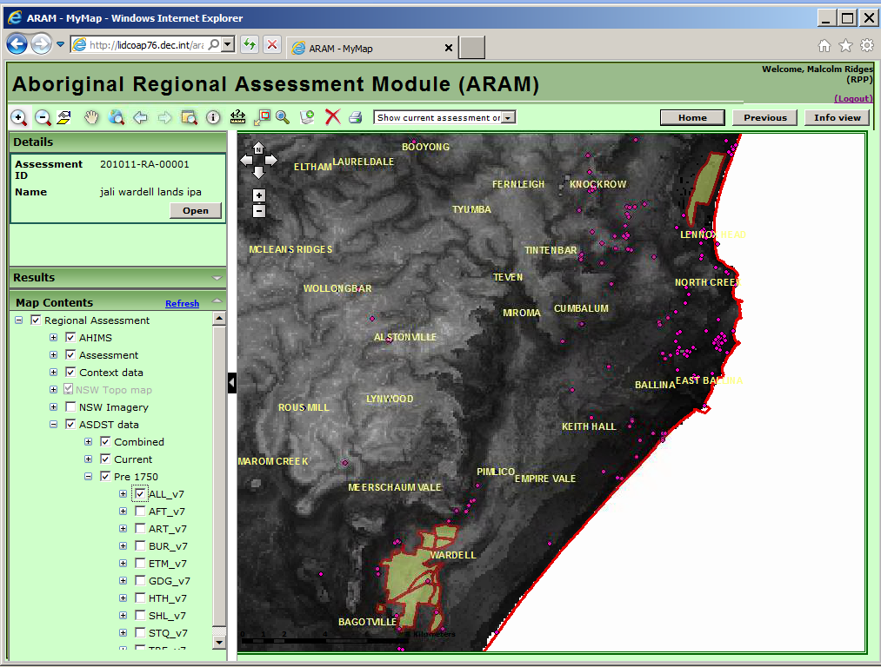
Top level information: generic information (metadata)

Slide 12
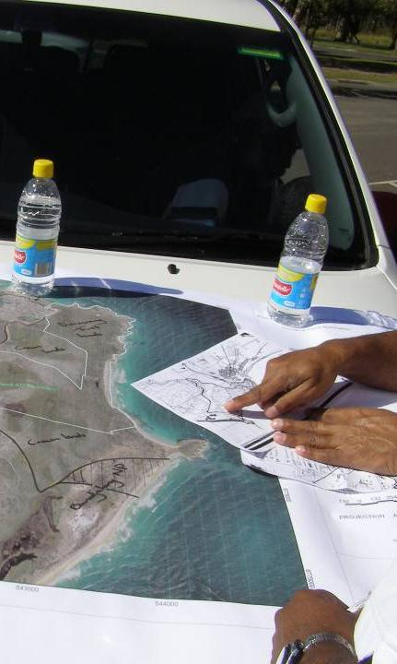
VIP mapping
VIP is a methodology for organising information about Aboriginal values
It is designed to protect sensitive data, while identifying information that can facilitate Aboriginal partnerships in landscape management
Value: something that is identified as being culturally important (eg a place, object, activity… anything nominated by a community)
Interest: the actions required to care for, interact with and appreciate a value
Priority: choosing which interest to do first with the resources available (ie funding or capacity), incorporating threats faced by different values

Slide 13
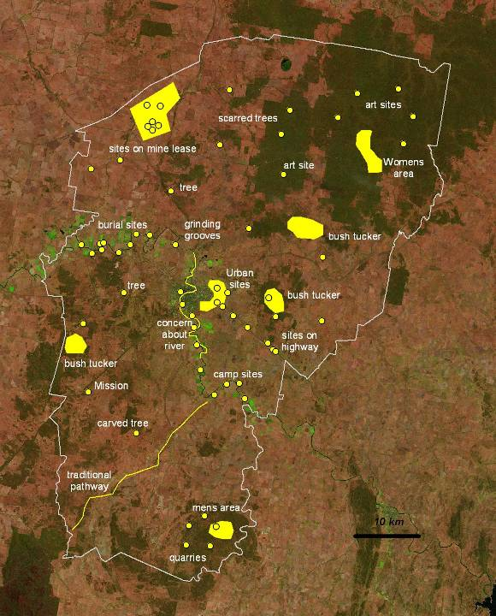
VIP Mapping 1
Values
These are the kinds of things that could be identified by a community in their landscape
With training from us, they undertake this process themselves
We leave large maps in the community and they annotate them over a period of weeks
NOTE: hypothetical example

Slide 14
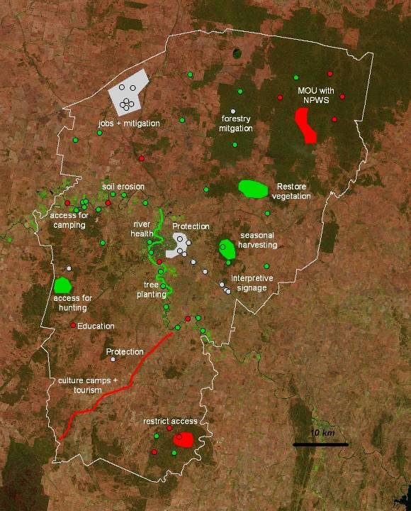
VIP Mapping 2
Interests
Values, on their own, don’t drive partnerships or outcomes, but ACTIONS do
So this step is about defining the INTEREST that communities have in defining the actions to care for values
This information is generally less sensitive, and more appropriately discussed in public forums like regional planning strategies
Cultural programs
NRM projects
Site protection issues
NOTE: hypothetical example

Slide 15
VIP Mapping 3
Priorities
National Park LOW threat
Mining HIGH threat
Not everything can be done in one funding cycle. So choices need to be made about what to focus on, & when
These choices can be informed by factors like threat, theme, community preference etc
By working through how to make these choices, and identifying priorities, it is easier to ensure the right projects get funded, and synergies with all the other programs existing in a landscape
FUNDING THEMES
Cultural programs
Cultural Programs
HIGH significance
NRM projects
Site protection issues
NOTE: hypothetical example

Slide 16
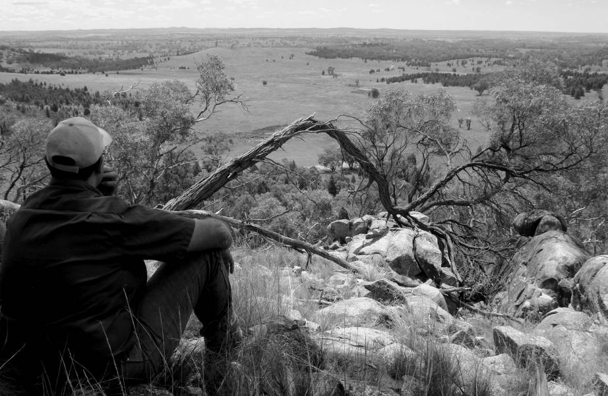
Take home message
There cannot be any ‘single point of truth’ for archaeological data
Communities must & WILL maintain control over data they decide is sensitive
What is made information; what becomes ‘federated’; is negotiated
This ‘federated’ information should be fit for purpose- ie people will contribute it if it delivers something for them

